Slide 1

Broadcast, Multicast and Unicast communication system in drone swarm/team
Course Instructor:
Prof. Alok Kanti Deb Sir
Electrical Dept.
IIT Kharagpur
Presented by:
Sai Joshitha Annareddy
21EE62R10
MTech CSE
IIT Kharagpur

Slide 2
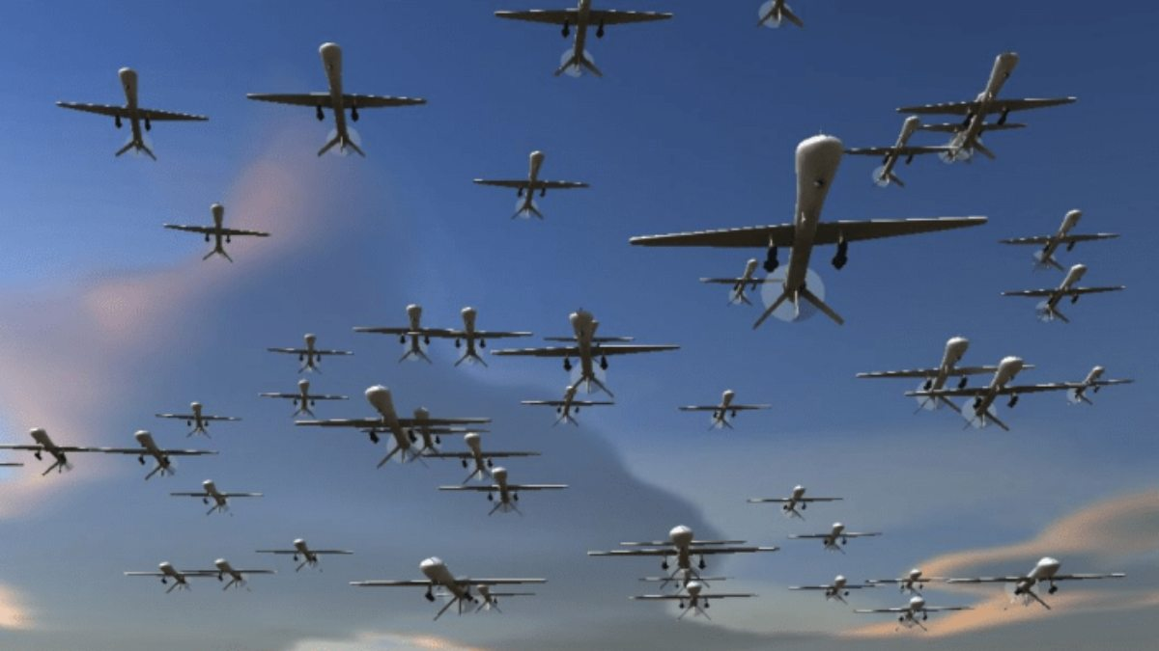
Drone Swarm/Team
“Drone swarm” refers to multiple drones flying similar to flock of birds in order to perform coordinated tasks.
The drone swarm system either can be remotely controlled or they are self controlled based on automation algorithm built during their development.
Often the phrase “drone swarm” means multiple drones being used at once. But in a true drone swarm, the drones communicate and collaborate, making collective decisions about where to go and what to do.

Slide 3
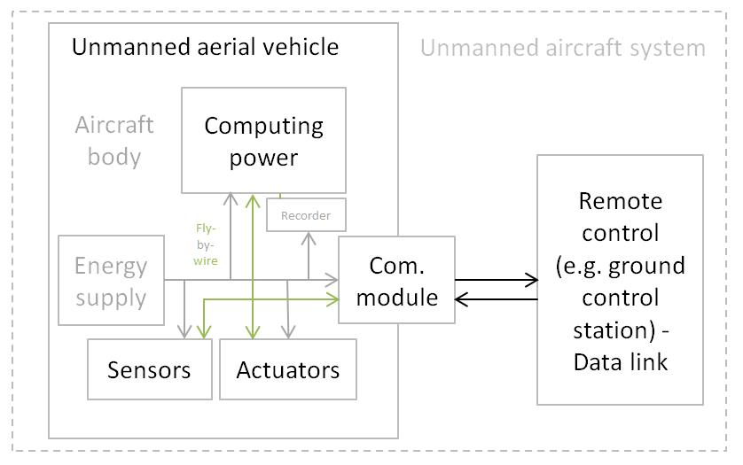

Slide 4
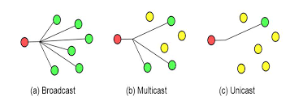
How do swarm drones communicate?
Unicast is the sending of messages to a single network destination host on a packet switching network.
Broadcast refers to transmitting a packet that will be received by every device on the network.
The third case is multicast. Multicast means transmitting a packet that will be received by the device which on the network.
The sender transmits data by broadcast. The receivers not be chosen as the destinations should be blocked.

Slide 5
Traditional UAV swarms use a computer as a GCS running a ground control software. The computers are equipped with a transceiver that sends and receives telemetry data from connected UAVs.
Higher levels of autonomy would allow drones to make decisions using on-board processing power.
There are two forms of swarm communication architecture
1. Infrastructure-based swarm architecture.
2. Ad-hoc network- based architecture.
Swarm with a large size requires a fully distributed communication system architectures and routing protocols which scales well and optimizes the “many-to-many” communication. At a basic level a drone swarm is a floating dynamic wireless network, commonly known as a wireless mesh network.

Slide 6

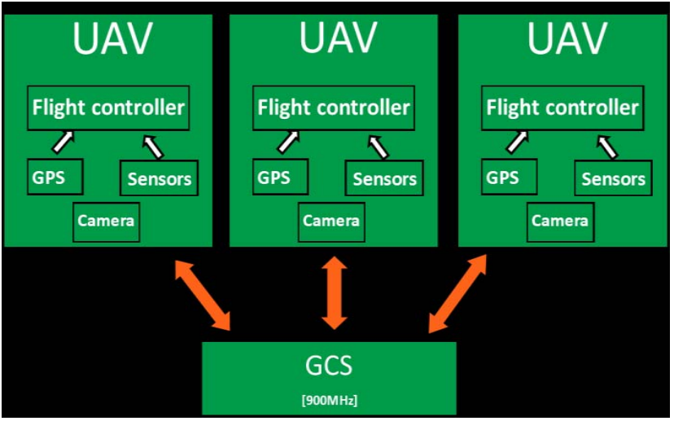
Infrastructure (GCS) based swarm architecture
Ground control station (GCS) receives telemetry information from all drones in the swarm and sends commands back to each UAV individually.
In other cases, a flight operation is pre-programmed aboard each UAV and the individual flight plans of each UAV are simultaneously operated while the GCS is simply used to observe the system.
These UAV swarms are considered to be semi-autonomous as they still require direction from a central control to complete the assigned task

Slide 7
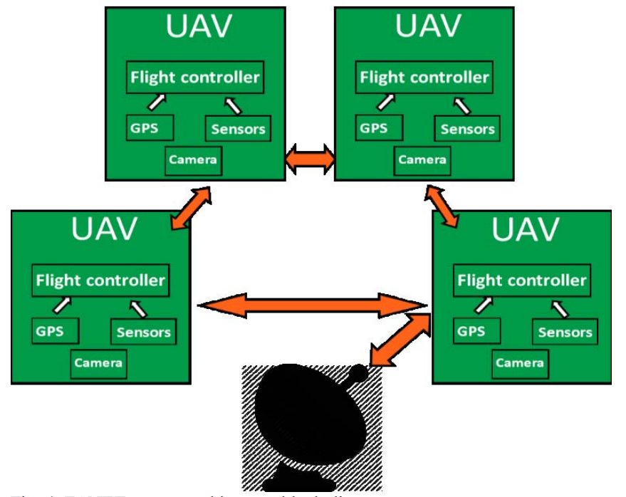
Flying ad-hoc network (FANET) architecture

Slide 8
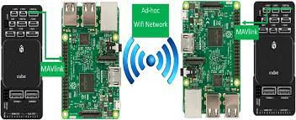
A wireless ad-hoc network (WANET) are wireless networks
that do not rely on existing infrastructure to establish the network.
No routers or access points are needed for an adhoc network.
Instead, nodes are dynamically assigned and reassigned based on dynamic routing algorithms.
This also provides built in redundancy as the entire swarm is not dependent upon an infrastructure to execute the desired tasks. This is the primary advantage of FANETs
To establish a FANET, networking hardware is required on board each UAV.
The distance over which UAVs can reliably communicate to one another in a FANET is a limiting factor to its implementation

Slide 9
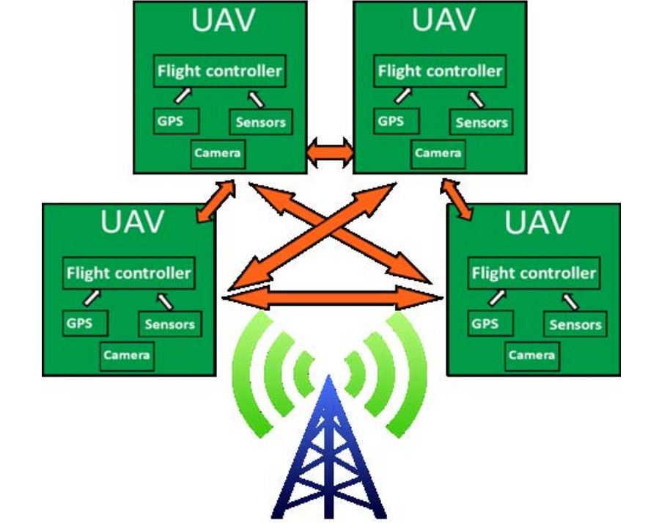
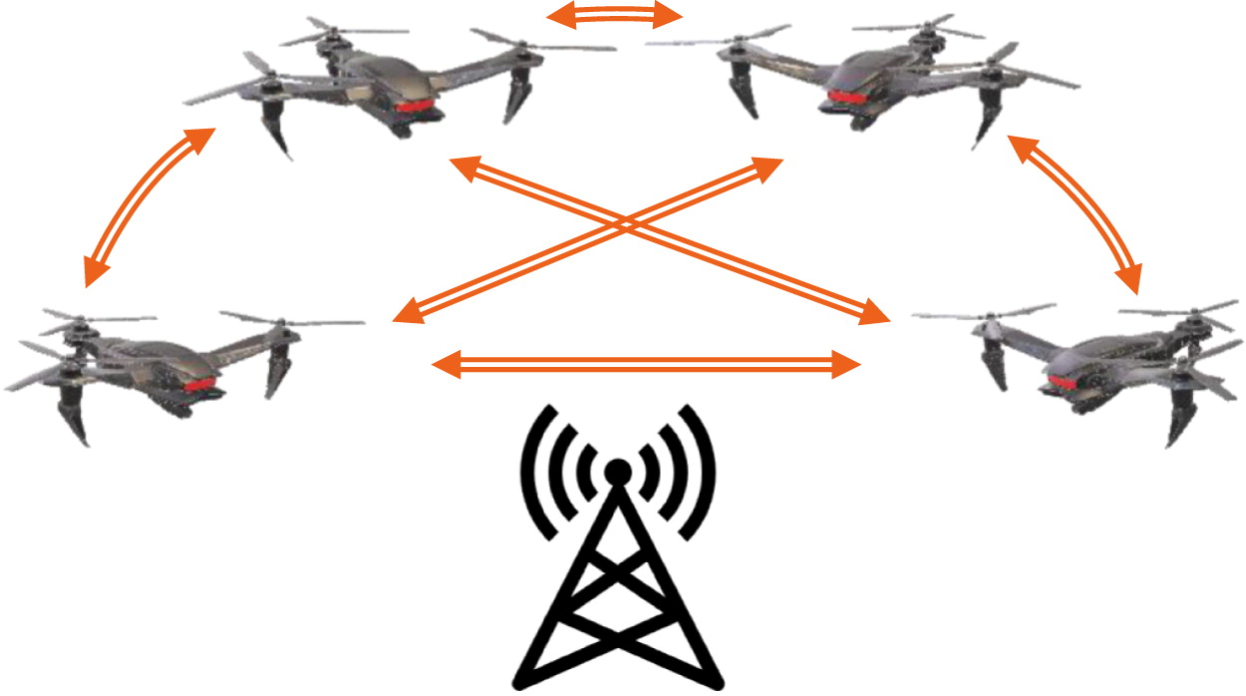
Hybrid network Architecture

Slide 10
A drone swarm can be modelled as a NCS(Networked Control System Model) encompassing a set of computational systems (i.e., the drones) connected via a communication network.
A NCS is a computational system that is controlled in a closed loop through a communication network.
Specifically, the control and feedback messages are exchanged among the system computational units, or agents, in the form of information packet transmitted through a network.
The functionality of a typical NCS is established using two basic elements:
(i) A computational system able to gather data via sensors, to reach decision and to perform commands via actuators;
(ii) A network, based on communication modules, standards and protocols (e.g., medium access control and routing) to enable the exchange of information.

Slide 11
Communication architecture and routing protocols
The communication architecture defines how information is exchanged between UAVs or between UAVs and the central control center. Routing protocols help provide reliable end-to-end data transmission.
Therefore, it is particularly important to design UAV swarm communication architectures and routing protocols with high performance and stability
Single-UAV systems need to maintain communication with the ground pilots or infrastructures at all times. By contrast, a multi-UAV system has only one specific UAV that communicates with the ground and forwards the message to other UAVs.
Further considering the U-T-U communication, the routing protocol plays an important role in achieving reliable end-to-end data transmission

Slide 12
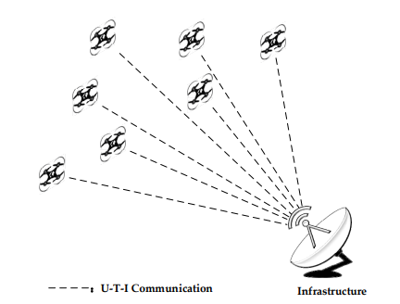
Centralized Communication Architecture
Centralized communication architecture evolved from single-UAV systems, and was implemented for UAV swarm technology.
Centralized communication architecture has the disadvantage of Single Point of Failure (SPOF).

Slide 13
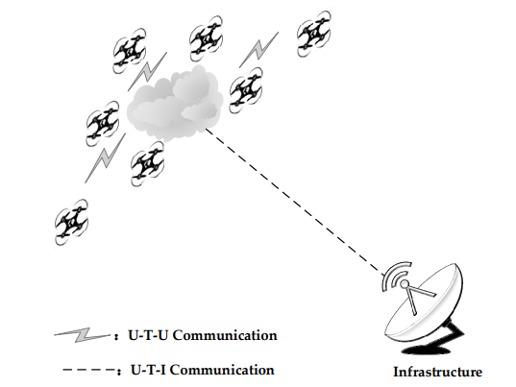
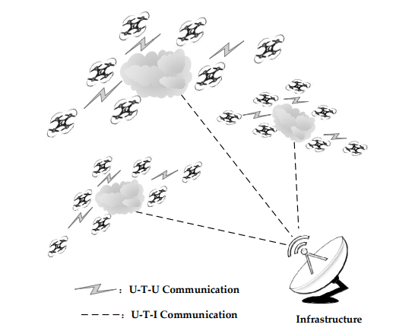
Decentralized Communication Architecture
Single-Group Swarm Ad hoc Network
Multi-Group Swarm Ad hoc Network

Slide 14
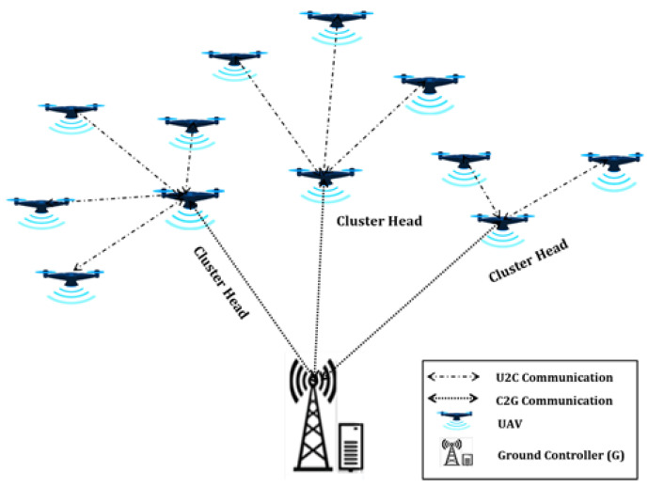
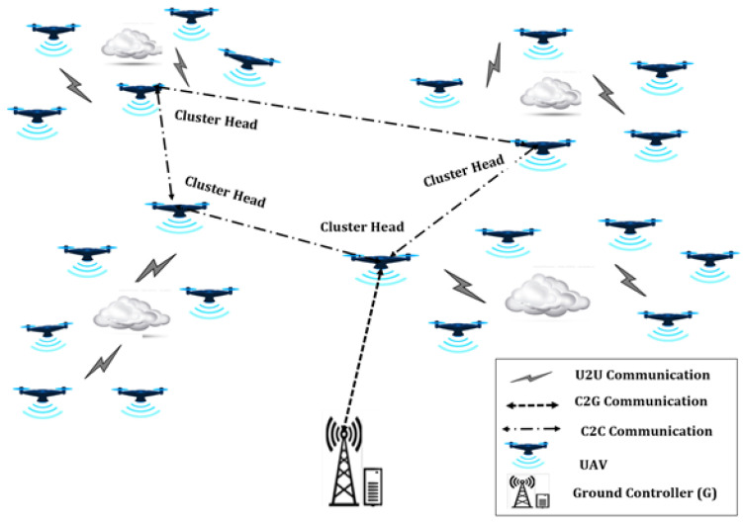
Cluster-Based Network
Cluster-based ad hoc interactive deployment.
Incorporation of drones in WSN (Wireless sensor network) efficiently is a strenuous work due to the positioning of dense sensors in a large area.

Slide 15
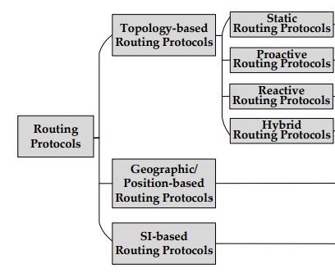
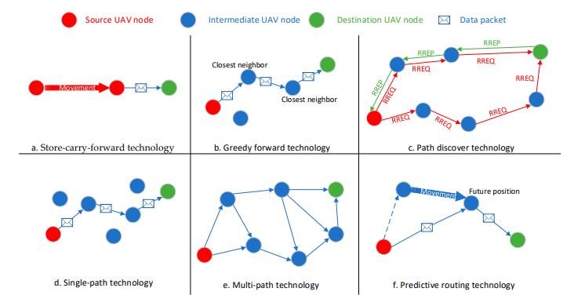
Routing Protocols

Slide 16
Swarm Intelligence
In a non-interactive deployment strategy, drones are controlled by the ground controller, meaning that this strategy relies on the existence of efficient uplinks and downlinks computational system
The goal of swarm intelligence is to leverage the operation of drone systems to exhibit advanced and complex swarm behaviours through their cooperation, organization and information exchange.
A swarm intelligence systems is made of a set of simple agents(drones in this case) interacting locally among themselves and with the environment.
In this context, swarm intelligence algorithms aim to control drone swarms in what concerns their behaviours based on two approaches namely optimization and consensus.

Slide 17
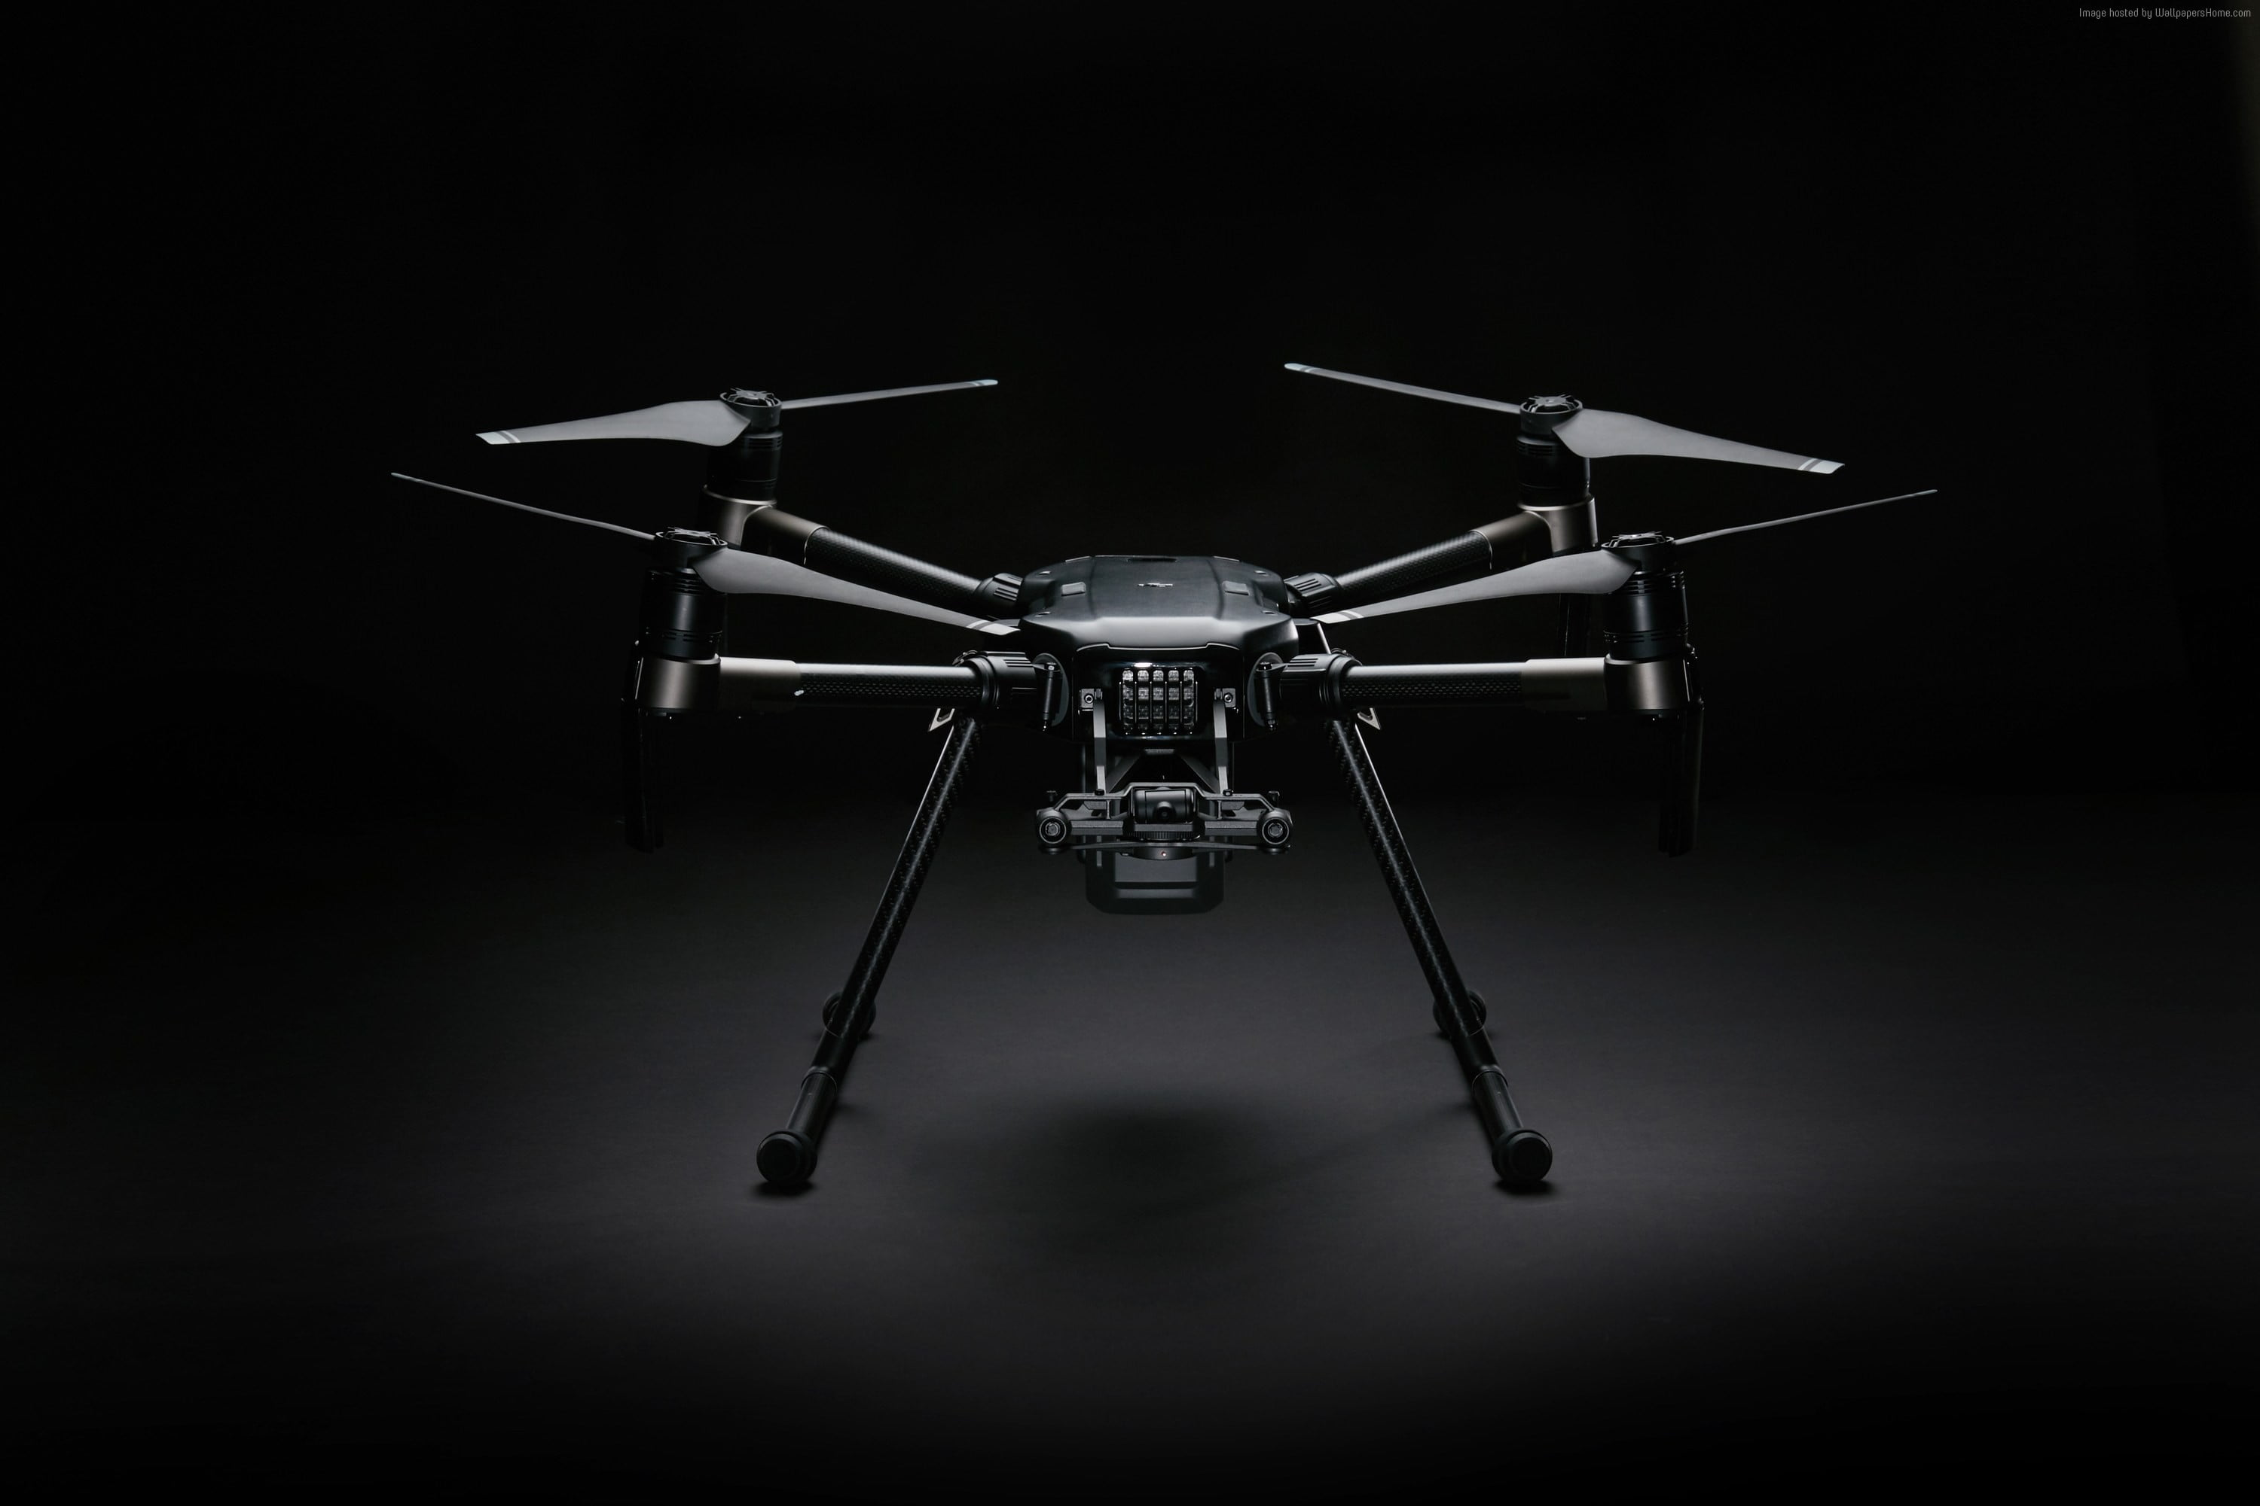
References
https://www.rfwireless-world.com/Terminology/How-Drone-Swarm-System-Works.html
Q. Cui, P. Liu, J. Wang and J. Yu, "Brief analysis of drone swarms communication," 2017 IEEE International Conference on Unmanned Systems (ICUS).
Mitch Campion, Prakash Ranganathan, and Saleh Faruque, Department of Electrical Engineering,“A Review and Future Directions of UAV Swarm Communication Architectures” , 2018 IEEE.
Xi Chen, Jun Tang and Songyang Lao College of Systems Engineering “Review of Unmanned Aerial Vehicle Swarm Communication Architectures and Routing Protocols”, , National University of Defense Technology, Changsha 410073, China; May 2020
Asaamoning, G.; Mendes, P.; Rosário, D.; Cerqueira, E. “Drone Swarms as Networked Control Systems by Integration of Networking and Computing Sensors” 2021, 21, 2642. https://doi.org/10.3390/ s21082642

Slide 18
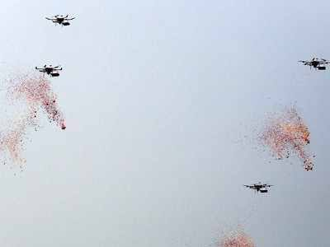
Thank you

